Slide 1
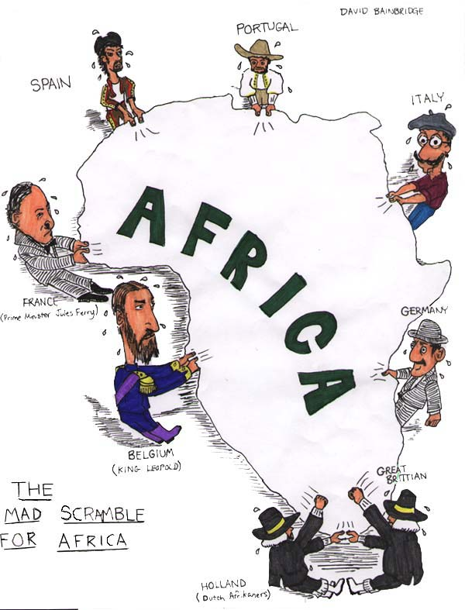
Imperialism

Slide 2
When you think of imperialism…..
http://www.youtube.com/watch?v=FFOEZh1Lbbg

Slide 3
The tentacles of GB reached far and wide

Slide 4
Imperialism video clip (4 min)
http://www.youtube.com/watch?v=OJe1W_HIWmA

Slide 5
Imagine for a moment…
that you are at home engaged in one of your favorite activities; playing a game, listening to music, or reading. So far the day is as any other. Then all of the sudden a group of individuals arrive at your front door demanding that you stop what ever you are doing. These individuals tell you that your way of life is wrong. They inform you however that they have come to your house to correct your way of life. They say it is their responsibility to change your way of living for the better. You find out that this has happened not only to you but your neighbors as well. Over time your way of life does change. These individuals, who you do not even know, have changed your government, religion, and other cultural practices, and remember these individuals told you this was for your own good. Now, what is going through your mind?

Slide 6
Let’s refresh our memories…
Who can tell me what’s a COLONY?
Does not have sovereignty (self rule) Example? The original 13 colonies
What is nationalism?
Extreme pride in one’s country
What occurred during industrialization?
Factories flourished, cities grew, and the demand for more products increased. With that came a need to find more raw materials.
The Industrial Revolution lead to “need” for Imperialism

Slide 7
WHAT IS IT?
Text book definition:
IMPERIALISM: the conquering of a country or territory by a stronger nation with the intent of dominating it politically, economically, socially and culturally.
Our definition: The Octopus!

Slide 8
“The Sun Never Sets on the British Empire”
A recent study showed that, in their history, Great Britain has invaded 90% of the countries in the world (all but 22). They have colonized 102 countries.

Slide 9
The All-reaching Empire

Slide 10
British Empire
British dominated 19th century imperialism
Reached it’s height under Queen Victoria
Since the Ind Rev started here, it makes sense they were one of the 1st Imperialist nations.
Originally about economics PRIDE
glorified imperialism in stories, newspapers, poetry
Ex. Kipling’s White Man’s Burden
Major Rivals:
France
Germany
Belgium

Slide 11
RHODES COLOSSUS
Cecil Rhodes, shown standing astride of Africa, in a cartoon from Punch magazine; Rhodes had built the trans-Africa railway, and is the man after whom the nation of Rhodesia was named (now Zimbabwe). The cartoon is a play on the old Colossus of Rhodes, which was one of the “Seven Wonders of the Ancient World.” There was an old statue in Greece depicting the Greek God Helios back in 290 BC)
“We [the British] happen to be the best in the world, with the highest ideals of dependency and justice and liberty and peace, and the more of the world we inhabit, the better it is for humanity.” SEE article from THE WEEK (in binder)

Slide 12
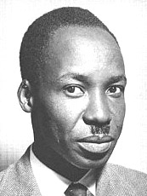
Perspective
“Our whole existence has been controlled by people with an alien attitude to life, people with different customs and beliefs. They have determined the form of government, the types of economic activity, and the schooling which our children have…A man who tries to control the life of another does not destroy the other any less because he does it, as he thinks, for the other’s benefit. It is the principle which is wrong, the principle of one man governing another without his consent.”
-Julius Nyerere of Tanzania

Slide 13
Partition of Africa

Slide 14
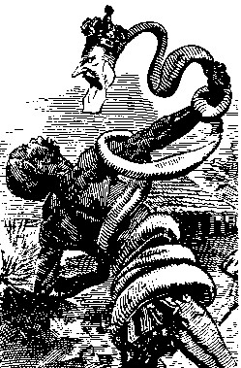
King Leopold of Belgium
The snake represents King Leopold and Belgium’s stranglehold that it had on the natives of Congo (rubber tree farms)

Slide 15
Imperialists divide Africa
Forces of Imperialism (pg 306-308)
Motives?
Technological Advantages?
Internal Factors causing African vulnerability?

Slide 16
Imperialists divide Africa
Berlin Conference 1884-85
rules establishing “fairness” in the European division of Africa
Rule #1:
Rule #2:
Africans never attended meetings
1914- _______and _______ only 2 remaining free African countries

Slide 17
ANALYZE THIS!

Slide 18
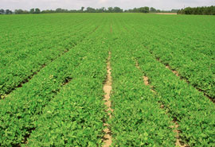
Imperialists divide Africa
Demand for Product Shapes Colonies
Europeans expected ________ to buy ______ goods – they didn’t
Europeans needs African colonies for raw materials and developed _________ PLANTATIONS
Cash-Crop Plantation? (pg. 308)
Examples:
Peanuts, cocoa, palm oil, rubber
Mineral resources: copper and tin

Slide 19
Imperialists divide Africa
Boer War (1899-1902)
Dutch Farmers (_____) originally settled South Africa in 1600’s.
_____ and _________ discovered in 1860s & 80s catching attention of ______
_______ invade – and eventually win
Boer Republics collected under _______ control
Union of South Africa

Slide 20
Racism (warped sense of nationalism)
Europeans believed they were superior to non-Europeans
Why?
Europeans (white man) had to take on the burden and responsibility of taming the heathens/civilizing savages (similar to Divine Right theory of Absolutism era)
Social Darwinism: “survival of the fittest…strongest will survive”
The “Haves” (Euros) and the “Have-nots” (Natives)
Christianity only “true” religion

Slide 21
White Man’s Burden by Rudyard Kipling (author of “the Jungle Book”)
Take up the White Man’s burden—
Send forth the best ye breed—
Go, bind your sons to exile
To serve your captives’ need;
To wait, in heavy harness,
On fluttered folk and wild—
Your new-caught sullen peoples,
Half devil and half child.
According to Kipling, what is the “White Man’s burden”?

Slide 22
The white man’s burden- The Journal, Detroit . 1899

Slide 23
Analyze this!

Slide 24
Forms of imperialism
Colony (Direct) – country governed internally by a foreign power (e.g. 13 Colonies)
Protectorate (Indirect) – country with its own internal government but under control of outside power (Puppet Government)
Sphere of Influence (Econ) – area in which an outside power claims exclusive investment or trading privileges (e.g. former Soviet Union…The US in Latin American late 1800’s/early 1900’s)
Economic Imperialism (no gov, just business)– independent but less developed nations controlled by private business interests rather than by governments (e.g. Dole Fruit company controlled pineapple trade in Hawaii)

Slide 25
Outcomes of imperialism FOR Africa (p. 315)
PROS:
Reduced civil war (local warfare)
Improved sanitation/hospitals = increased life span
Greater infrastructure: building of schools, railroads, bridges, etc
Economic expansion (better jobs, steady pay, etc)
CONS:
Loss of land and independence
Death from new diseases (smallpox)…bacteria brought by Euros
Lives lost in resistance against the Euros
Famines as a result of shifting from subsistence crops to cash crops

Slide 26
Crumbling Ottoman Empire…p. 318
…it once reached from Hungary to Greece
Location, Location, Location….World powers are interested in their strategic location
Russia interested in control of Black Sea
Why? Water access to Mediterranean and Atlantic (warm water port)
Crimean War: 1853
Russia takes on Ottoman Empire for Black Sea territory.
GB & France come to aide of the Ottomans
They didn’t want Russia to get any land (land = power)
The Russians were defeated but the Ottomans would go on to lose lands in the Balkan Peninsula and North Africa
FYI…..1st war where women served as Army nurses and correspondents covered the war as news reporters

Slide 27
Euro interests in Middle EAst
OIL discovered in Middle East prompts European interest
Egypt and Persia (modern day Iran) implement political and social reforms to block European take-over
They saw what had happened to the Ottomans and wanted to prevent that from happening here.

Slide 28
Egypt’s modernization…p.318
Muhammad Ali (not the boxer!) developed this cash crop:
COTTON
The Suez Canal was built
The French engineered it with Egyptian labor
Egypt borrowed $ from France who in turn borrowed $ from GB
If India was the “Jewel of the Crown”, then the Suez Canal was the “Lifeline of the Empire”….why do you think so?

Slide 29
Using the Suez Canal saves approximately how many miles on the trip from India to London?

Slide 30
Canal Changes Hands…
Construction began in 1859….it 0pened in 1869
Even as of today, it contains NO Locks. It is single lane with two designated passing places….seawater flows freely. Little elevation in exit/entrance points so no need for water elevator! However, both access points are subject to tsunamis (natural wake created).
1882 - When Egypt could not pay interest on its debt, Britain occupied Egypt and took over control of the canal.
Why was British support of the canal valuable to them?
“I approve of the continued occupation of Egypt…the necessity for using every legitimate opportunity to extend our influence and control in that great African continent which is now being opened up to civilization and to commerce…” Joseph Chamberlain, 1894
Read, Suez Canal Article (?)
P. 319…complete Geography activity

Slide 31
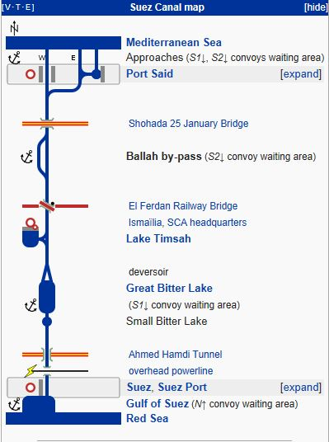
Suez canal

Slide 32
Suez Canal From space

Slide 33
Persia’s modernization p. 319-320
Persia granted concessions (access) to Western corporations to raise $
Westerners interested in business were granted rights to develop these industries
GB gets access to oil fields (major commodity)
GB creates buffer b/w Russia & India – Why?
1907- GB & Russia divide most of Persia into spheres of influence
These are essentially colonies
Russia
Persia
India

Slide 34
Conclusion:
Why did Europeans want to gain influence in the Middle East?
Economic imperialism
Strategy (location)

Slide 35
Imperialism in INDIA

Slide 36
“The jewel in the crown”
India was the largest and most lucrative colony of the entire British Empire.
1600’s British East India Co. began trading in India; over time gaining more economic and POLITICAL control

Slide 37
Hindus vs. Muslims
Hindus outnumbered Muslim Indians 2:1
History of poor treatment of Hindus by fallen Muslim Mughal Dynasty caused much distrust b/w two groups
Many Hindus favored GB over Mughal Dynasty
GB will use religious division of Indians to their advantage

Slide 38
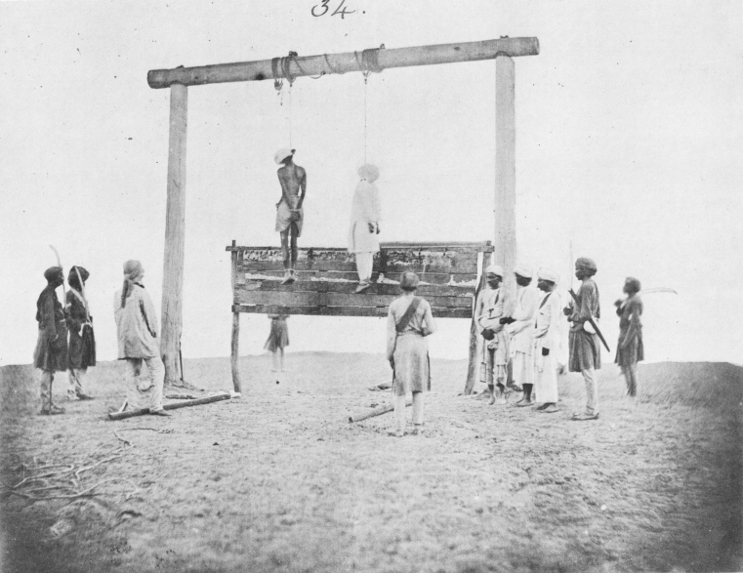
Sepoy rebellion (Mutiny)
Sepoy = Indian soldier (for East Indian Trading Company)
Spurred on by strong feelings of resentment and nationalism against the British
Sepoy soldiers imprisoned for refusing gun cartridges due to rumors of beef and pork fat seals (these animals are sacred in their religions)
May 10, 1857-Sepoys rebelled and took Delhi
Took more than a year for East India Co to regain control
Lead to eventual full colonization of most of India called the Raj (term for the rule of GB over India from 1757-1947).
Some Indians remained loyal to East India Co and were granted special privileges, many however were developing more hatred toward GB

Slide 39
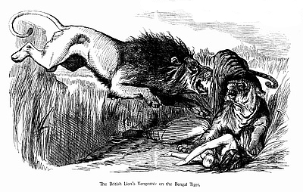
The British lion’s vengeance on the bengal tiger

Slide 40
Long-term outcomes of colonization
Resurgence of nationalism against GB
This prompts the creation of:
Indian National Congress-1855
Mix of all Indians Hindu and Muslim)
Muslim League-1906
Just Muslim Indians
Goal: push for independence and protection of Muslim rights
Strong tension continues to develop b/w Hindus and Muslims as nationalism is on the rise

Slide 41
Imperialism in china

Slide 42
West interested in china
China was under control of QING Dynasty since 1611. They looked down upon foreigners
China had experienced a long self-sufficient history (didn’t need to trade with, but interested in trading to)
Produced many products and had a vast population; 2 things that interested the West
Agriculture was basis of their wealth: Tea, rice, maize, sweet potatoes, peanuts, cotton - silk
Mining: salt, tin, silver, iron ore
3 big items: Tea, porcelain, silk
Western countries were not interested in colonizing China they just wanted to make $ off of them
Spheres of Influence
Economic Imperialism

Slide 43
West interested in china
China traded at one of their ports and the balance was in their favor. They traded tons of tea to GB while what they got from them was worth much less….GB had to pay balance in silver.
Thus, GB needed something that the Chinese would want. They eventually found it – Opium! (very addictive drug made from poppy plant). It had been used by doctors as a pain reliever.
GB smuggled it into China for recreational use and by 1835, 12 million out of the 300 million people in China, were hooked.

Slide 44
Opium war: 1839
China declares war against GB
Most battles at sea
China is trying to prevent British importation of Opium
China’s Navy is outmatched by the British.
China is humiliated and in 1842, they sign the Treaty of Nanjing (also spelled Nanking)
This treaty gave GB the exclusive rights to Hong Kong (a lucrative port city that they would hold until 1997). GB also received extraterritorial rights (provided exemption from Chinese law in four other port cities).
The opium trade continued!
Let’s read more about it (Read and Respond)

Slide 45
Taiping rebellion: 1853
Aside from foreign invaders, China had a major hunger issue. Their population had exploded and they didn’t have enough of a supply to meet this demand.
Corruption was rampant. Rebellion was imminent.
14 year rebellion
lead by Hong Xiuquan (shee-quan)
Peasants against corrupt Chinese gov’t and poor economy
He wanted a “Heavenly Kingdom of Great Peace”(Everyone share in China’s wealth). Taiping means “great peace”.
His army grew to 1 million but eventually it is defeated by Imperial troops and with the help of the British and French (Why them?)

Slide 46
Self-Strengthening Movement: 1860s
REFORM is needed….millions of people died in the rebellion and/or starved.
Chinese Gov’t aimed to update educational system, diplomacy, and the military.
Chinese learning from western models of reform.
Reform to take place under the leadership of the Empress Dowager Cixi (tsoo-shee) – the head of the Qing Dynasty.

Slide 47
Open door policy: 1899
Turn to p. 338 and view the map of foreign influence in China. Answer the 2 questions.
US policy that proposed China’s “doors” be open to merchants of all nations. They suggested this because we were fearful that we would be shut out of this important trading marriage.

Slide 48
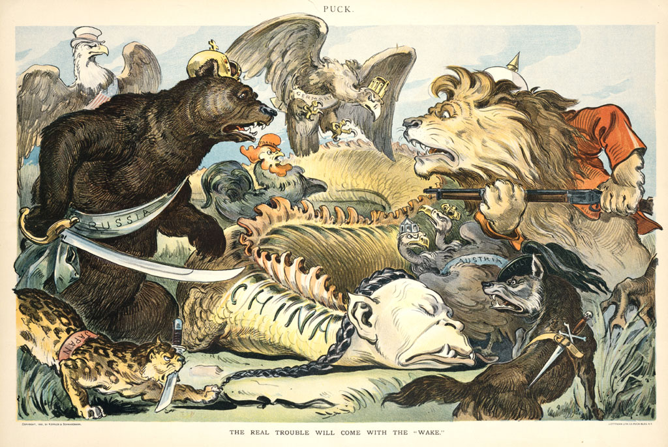
Open door policy A more aggressive cartoon

Slide 49
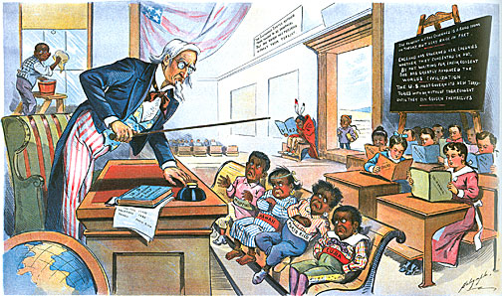
The US was no innocent bystander….

Slide 50
Boxer rebellion: 1900
Chinese Nationalism will grow due the humiliation of foreign influence in their country.
The Empress’s nephew (the new emperor) started to institute some reforms that would actually help the country (education, economic, military). He brought in advisors to help.
Many of the Qing officials saw this as a threat to their power. So they called the Empress back to power. She returned and had many executed.
This would lead to more frustration in the country. Fed up with famine and special concessions for foreigners, peasants led the Boxer Rebellion.
Lead by the “Society of Harmonious Fists” (Boxers)
Wanted to take back China from foreign influences
Called for death to all foreign “devils”
The rebellion was squashed by troops from GB, France, US, Germany, Austria, Russia, Japan (Why?)
At this point, the Dynasty realized they needed to overhaul their country. They did, but unrest will follow until Mao and Communism took over in the 1940’s.

Slide 51
Imperialism in japan

Slide 52
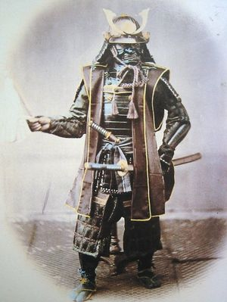
Japan modernizes
17th C. Japan begins isolation from other nations
Under the rule of the Tokugawa Shoguns, society was a tightly run ship
(feudal system)
Japan had peace and prosperity for 2 centuries
Engaged in trade with China and Dutch traders from Indonesia & had diplomatic relations with Korea

Slide 53
Treaty of Kanagawa: 1854
British, French, Russian, and US ships routinely anchored off shore of Japan in an effort to convince them to trade. (12 nautical miles – territorial/international waters)
In 1853, US Commodore Matthew Perry sailed into what is now the port of Tokyo with 4 massive steam powered ships (cannons/rifles on display). He delivers a letter from President Fillmore asking to open trade with US.
It was a friendly letter but Perry said he would be back in a year with a much larger fleet for the response.
They sign the treaty and Japan opens 2 ports for US ships to take on supplies
US sets up Embassy as per the terms of the treaty.
Many European nations will follow suit gaining extraterritorial rights in these ports (free from Japanese law)

Slide 54
Meiji Era Begins: 1867-1912
Meiji means“Enlightened Rule” under Emperor Mutsuhito
Shoguns/Samurai want to hold on to the ancient way of doing things so thus they are at war with the Emperor who wants to modernize.
Mutsuhito believes Japan must adopt western ways to keep westerners out. They modeled much of what they were going to do after Germany (constitution, gov’t framework, army)
Massive movement of modernization
Emperor Mutsuhito

Slide 55
Sino-Japanese war: 1894
Sino is a prefix that used to refer to China
Japan’s attempts at modernization pay off. They eliminate extraterritorial rights (Europeans agree to this). Japan’s confidence rises. So too does their imperialistic ways.
Japan attacked Chinese troops in Korea
Japanese destroy Chinese Navy and drive China out of Korea. They also invade Manchuria (mineral rich area in present day China). As part of treaty, they receive their 1st colonies: Taiwan and Pescadores Islands

Slide 56
Russo-Japanese war: 1904
Many were surprised by the Japanese victory. Now it is the Japanese and the Russians as the superpowers in East Asia.
Japan launches surprise attack on Russians off the coast of Manchuria. They win.
Pres Teddy Roosevelt drafts treaty in Portsmouth, NH. It gave Japan the captured territories and made Russia leave Manchuria and Korea.

Slide 57
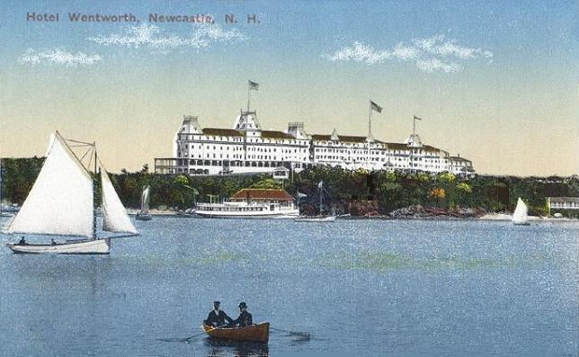
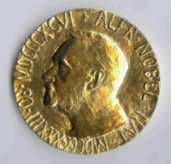
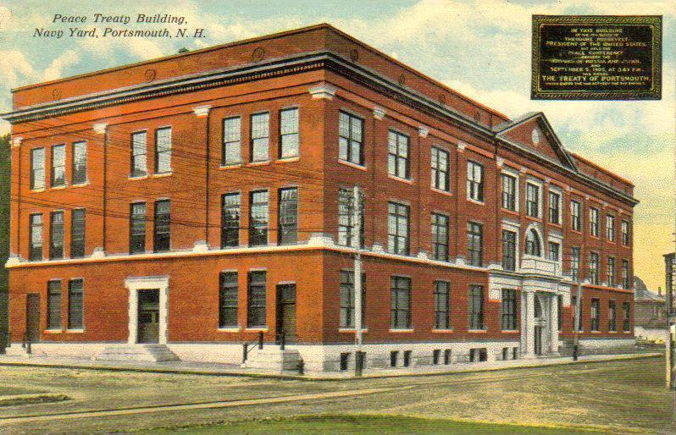
Portsmouth Peace Treaty - 1905
US Navy (shipyard in Portsmouth), State of NH, and city of Portsmouth hosted
Roosevelt wanted a non-descript, neutral site for the peace talks. He had confidence in the Navy
This would be the 1st international peace treaty signed in the US at 3:47pm. This moment has been commemorated with bells ringing and a donation of 3,000 cherry trees from Japan to mark the event
Delegates stayed in the Hotel Wentworth and were ferried across a river to the Naval Base for negotiations. Treaty was signed at Hotel
Teddy Roosevelt won the Nobel Peace Prize in 1906 for brokering this agreement
This is the building in the Navy Shipyard were negotiations occurred

Slide 58
Japan annexes Korea: 1910
1907: Korean King gives up control
1909: Korean Imperial Army disbanded
Japan harshly rules Korea (no public protest, no newspapers, Korean schools were shut down and Japanese curriculum installed)
They did help modernize Korea, but they brutally kept order.
Japan imposes annexation of Korea; keeps it until end of WWII

Slide 59
Long-term outcomes of Japanese Imperialism
Japan develops large Pacific Empire; and major competitor to the West
Japan becomes most industrialized country in Asian Pacific
Japan consistently interested in China and will make several attempts to take it
In reflection, what did Japan do right and China do wrong when trying to modernize? (see next slide)

Slide 60
Long-term outcomes of Japanese Imperialism
They fully adopted the ways of the west!

